Slide 1

Big Data Analytic 2

Slide 2

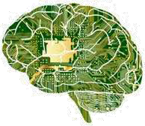


Big Data Analytics → Concept
Concept
+
=
Big Data
Data Acquisition Data Storage
Analytics
Data Analysis Data Quality
Data Visualization Business Intelligence (BI) OLAP (Online Analytical Processing)
Machine Learning (ML) AI (Artificial Intelligence)
Big Data Analytics

Slide 3


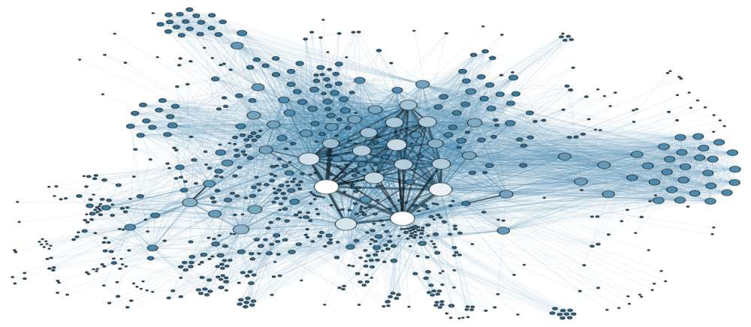









Big Data Analytics → Concept
Concept
A wide cloud of data in dynamic flows.
devices
documents
sensors
transactions
logs (tracks)
videos
spatial coordinates
Images
software
Bar codes
RFID

Slide 4



Big Data Analytics → Concept
Concept
A wide cloud of data in dynamic flows.
In order to take advantage of these huge Data and understand them
We have to read them, to classify them, to explore them
BUT…!

Slide 5
Big Data Analytics → Concept
Concept
A wide cloud of data in dynamic flows.
banking transactions
GPS coordinates
Unstructued Data
Facebook posts
…
text
Supports and heterogeneous formats
Data Bases
Media: Images, videos
Files (pdf, word, binay, etc.)
Bar cordes, RFID, etc.
…

Slide 6


Big Data Analytics → Concept
Concept
A wide cloud of data in dynamic flows.
Diversity in Data sets makes the mining complex by humans and even by machines !
Hence the use of advanced methods to mine
All of these methods constitute the BIG DATA ANALYTICS

Slide 7
Big Data Analytics → Concept
Concept
Big Data Analytics are the set of tools that aim to process the stored Big Data in order to :
Reveal hidden patterns,
Discover unknown correlations,
Forecasting market trends,
Finding customer preferences,
Accurating forecastings,
Unconvering unexpected information and knowledge.
• …

Slide 8
Big Data Analytics → Role
Role
Descriptive Analytics:
What happened
Diagnostic Analytics:
How it happened
Predictive Analytics:
What will happen
Prescriptive Analytics:
What should happen
Cognitive Analytics:
Make it happening
Artificial Intelligence
Automation

Slide 9























Big Data Analytics → As a field
As a field
Statistics
Mathematics
Computer Science
Data Analysis
Machine Learning
Big Data
OLAP
Business Intelligence
Data mining
Artificial Intelligence
Big Data Analytics

Slide 10


























































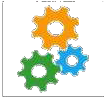
Big Data Analytics → Technically
Technically
Social media
Cloud Coomp.
Middle wares
ERP
Data Sources
datawar^{d}hªo^{ta}u^{m}se^{art}
1
IoT
Unstructured Data
Structured
IoT
Data
datamart
Data Accumulation
Daya Analytics

Slide 11
Big Data Analysis Techniques
Quantitative Analysis
Quantitative analysis is a data analysis technique that focuses on quantifying the patterns and correlations found in the data. Based on statistical practices, this technique involves analyzing a large number of observations from a dataset.

Slide 12
Quantitative analysis results are absolute in nature and can therefore be used for numerical comparisons. For example, a quantitative analysis of ice cream sales may discover that a 5 degree increase in temperature increases ice cream sales by 15%.

Slide 13
Qualitative Analysis
Qualitative analysis is a data analysis technique that focuses on describing various data qualities using words. It involves analyzing a smaller sample in greater depth compared to quantitative data analysis. These analysis results cannot be generalized to an entire dataset due to the small sample size.

Slide 14
Data Mining
Data mining, also known as data discovery, is a specialized form of data analysis that targets large datasets. In relation to Big Data analysis, data mining generally refers to automated, software-based techniques that sift through massive datasets to identify patterns and trends.
Figure 8.4 The symbol used to represent data mining.

Slide 15
Statistical Analysis
Statistical analysis uses statistical methods based on mathematical formulas as a means for analyzing data. Statistical analysis is most often quantitative, but can also be qualitative. This type of analysis is commonly used to describe datasets via summarization, such as providing the mean, median, or mode of statistics associated with the dataset. It can also be used to infer patterns and relationships within the dataset, such as regression and correlation.
A/B Testing
Correlation
Regression

Slide 16
Correlation
Correlation is an analysis technique used to determine whether two variables are related to each other. If they are found to be related, the next step is to determine what their relationship is. For example, the value of Variable A increases whenever the value of Variable B increases. We may be further interested in discovering how closely Variables A and B are related, which means we may also want to analyze the extent to which Variable B increases in relation to Variable Aâ€™s increase.

Slide 20
Regression
The analysis technique of regression explores how a dependent variable is related to an independent variable within a dataset. As a sample scenario, regression could help determine the type of relationship that exists between temperature, the independent variable, and crop yield, the dependent variable.

Slide 23
Machine Learning
Humans are good at spotting patterns and relationships within data. Unfortunately, we cannot process large amounts of data very quickly. Machines, on the other hand, are very adept at processing large amounts of data quickly, but only if they know how.

Slide 24
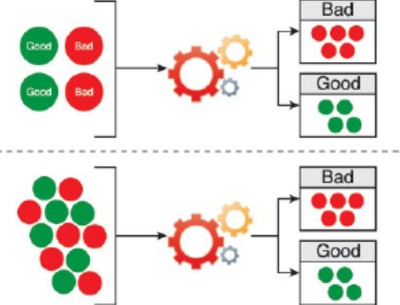
Classification (Supervised Machine Learning)

Slide 25
Clustering (Unsupervised Machine Learning)

Slide 26
Outlier Detection

Slide 27
Filtering
collaborative filtering
content-based filtering

Slide 28
Semantic Analysis
• Natural Language Processing
• Text Analytics
• Sentiment Analysis

Slide 29
Visual Analysis

